Slide 1
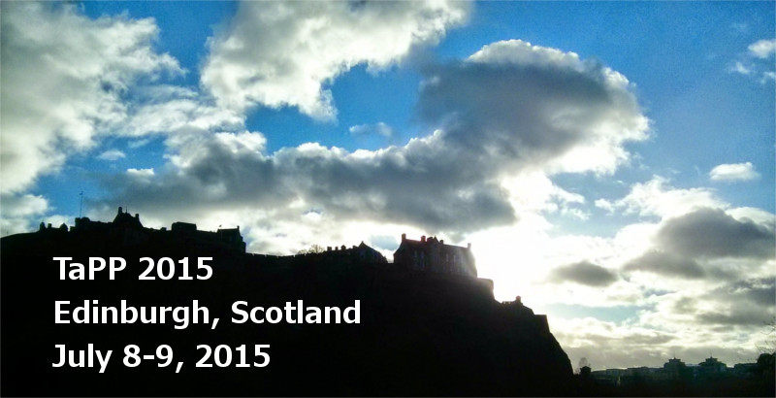



Retrospective Provenance without a Runtime Provenance Recorder
Timothy McPhillips Shawn Bowers
Khalid Belhajjame Bertram Ludäscher*

Slide 2
Overview / Exec Summary
Scientific Workflows: ASAP!
Scripts are Scientific Workflows, too!
.. so how can we help workflow script authors?
YesWorkflow (YW)
Prospective provenance through YW-annotations:
script + annotations @begin, @end, @in, @out => workflow model
YW-Recon: Retrospective provenance without a provenance recorder:
.. add @URI template-annotations
=> linking script persisted (meta-)data with workflow model
... => YW Retrospective Provenance Queries
.. using YW workflow model to query YW-reconstructed runtime provenance!

Slide 3
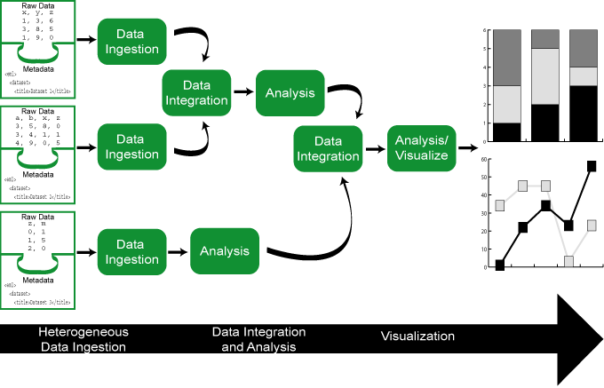
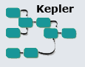





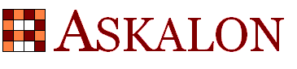
Scientific Workflows: ASAP!
Automation
wfs to automate computational aspects of science
Scaling (exploit and optimize machine cycles)
wfs should make use of parallel compute resources
wfs should be able handle large data
Abstraction, Evolution, Reuse (human cycles)
wfs should be easy to (re-)use, evolve, share
Provenance
wfs should capture processing history, data lineage
➔ traceable data- and wf-evolution
Reproducible Science
VisTrails
Trident
Workbench
Es war einmal …

Slide 4
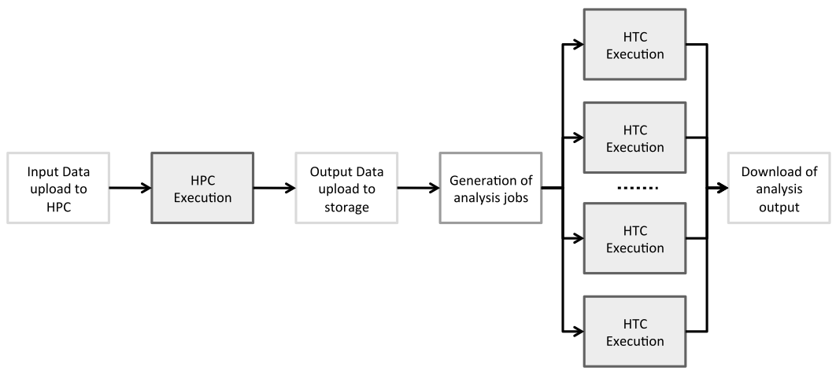
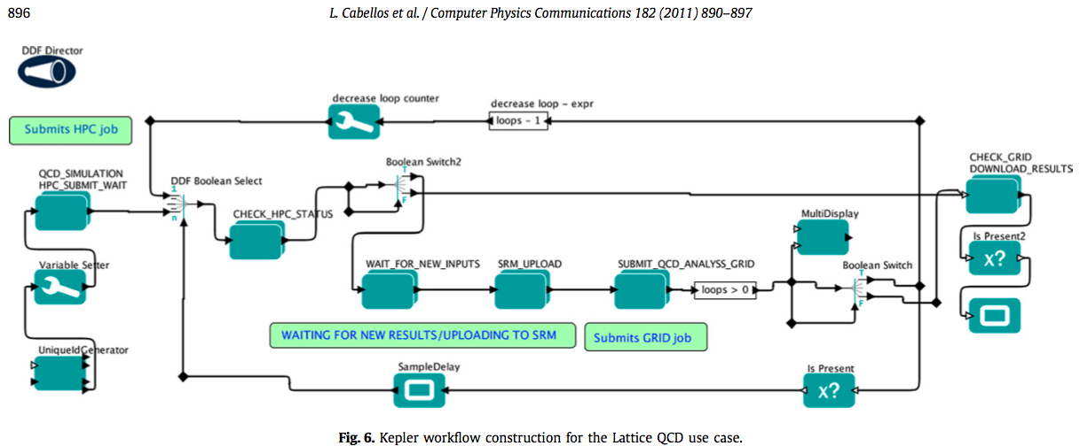
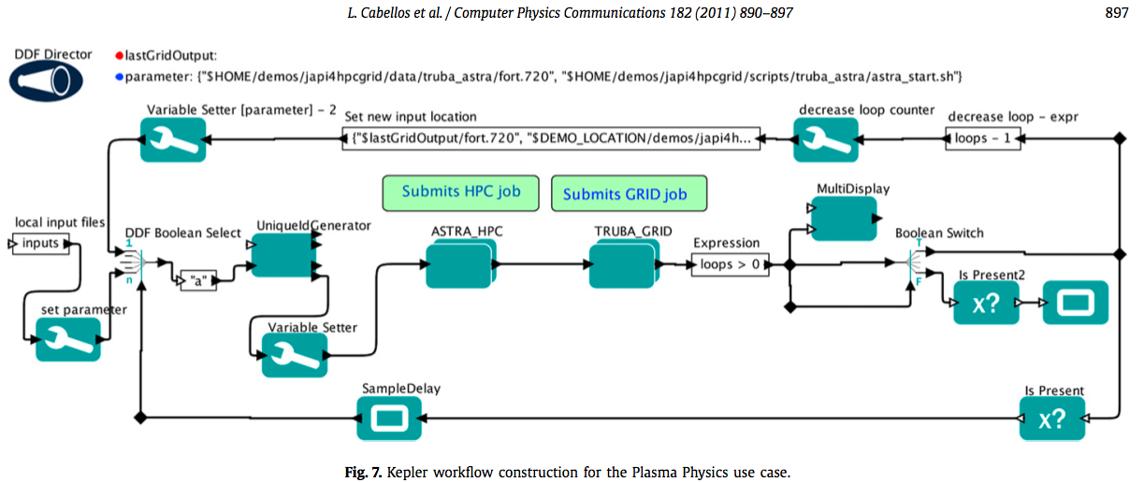
Scientific Workflows …
Cabellos et al. Computer Physics Communications 182, 2011

Slide 5
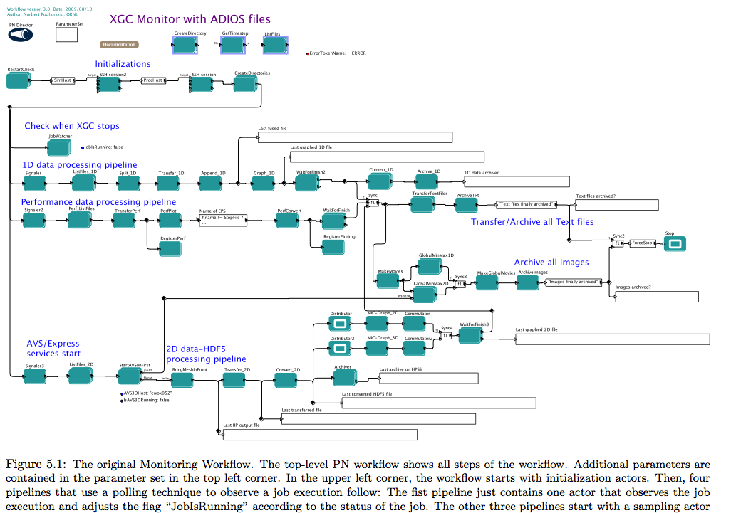
… are a wonderful thing …
Dr. Norbert Podhorszki
(then: UC Davis)

Slide 6
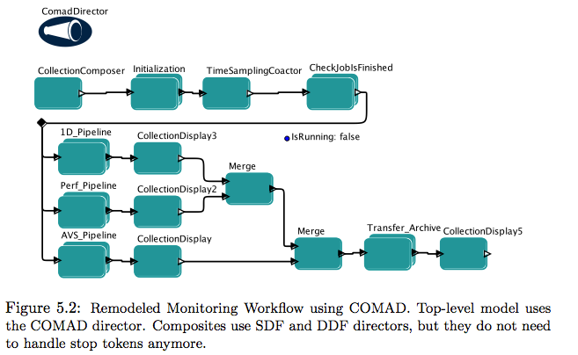
… after simplifying a bit (here: Kepler/COMAD)
Dr. Sven Köhler
(then: UC Davis)

Slide 7
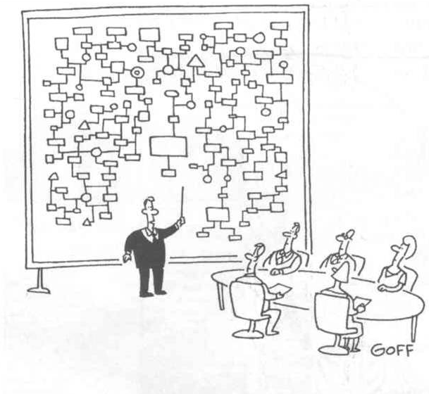
I beg your pardon, I never promised you ..
“Thanks to our Graphical UI your scientific workflows will be much easier to develop, understand and maintain!”
Hmm… this was supposed to be easier than programming!

Slide 8
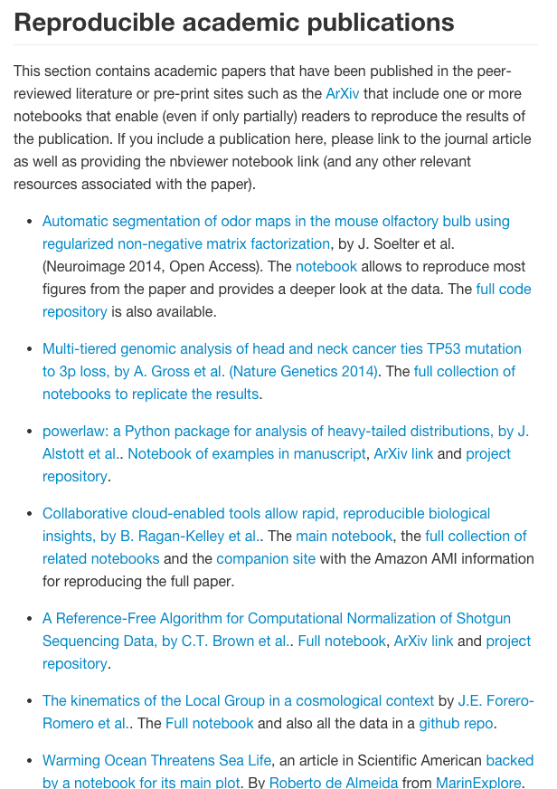
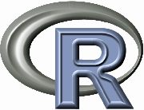
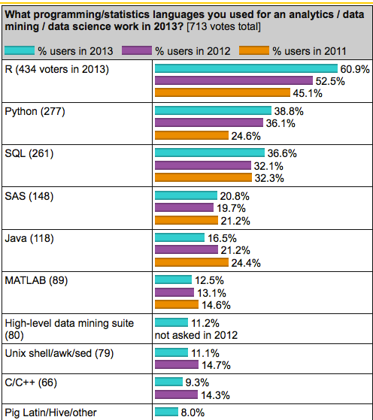
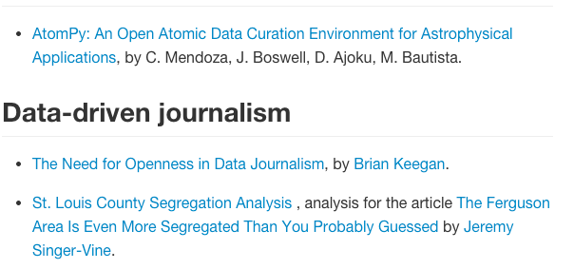
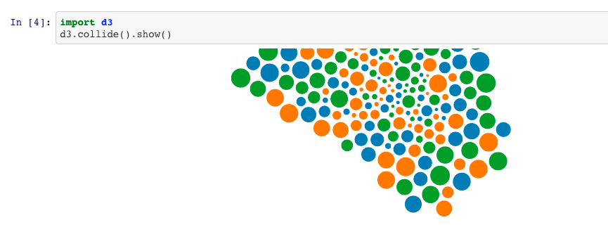
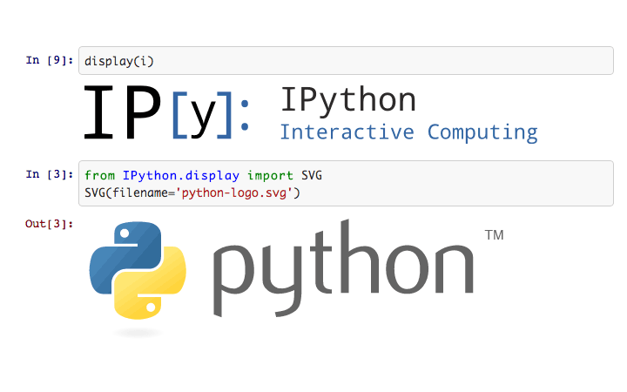
Meanwhile, on a nearby planet …
Interactive Visualization

Slide 9
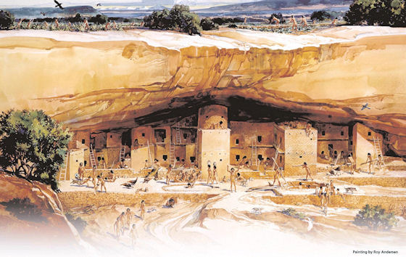
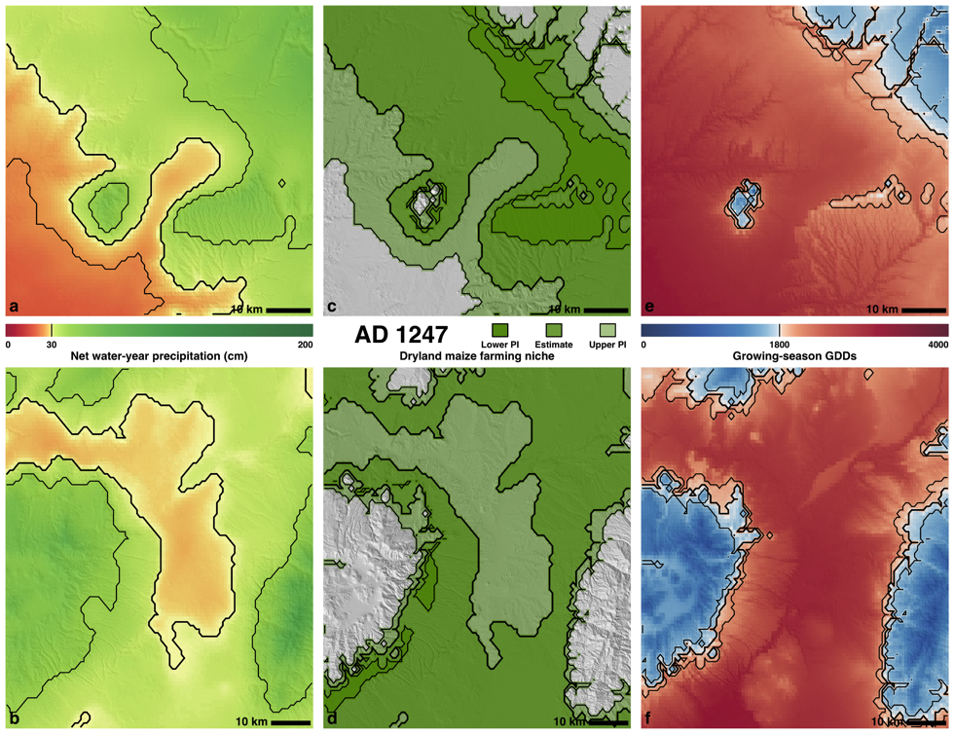
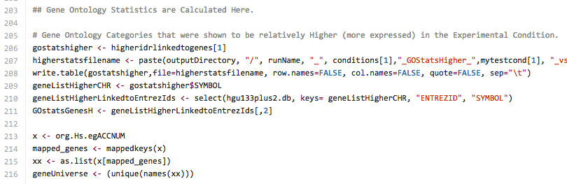
SKOPE: Synthesized Knowledge Of Past Environments
Bocinsky, Kohler et al. study rain-fed maize of Anasazi
Four Corners; AD 600–1500. Climate change influenced Mesa Verde Migrations; late 13th century AD. Uses network of tree-ring chronologies to reconstruct a spatio-temporal climate field at a fairly high resolution (~800 m) from AD 1–2000. Algorithm estimates joint information in tree-rings and a climate signal to identify “best” tree-ring chronologies for climate reconstructing.
K. Bocinsky, T. Kohler, A 2000-year reconstruction of the rain-fed maize agricultural niche in the US Southwest. Nature Communications. doi:10.1038/ncomms6618
… implemented as an R Script …

Slide 10

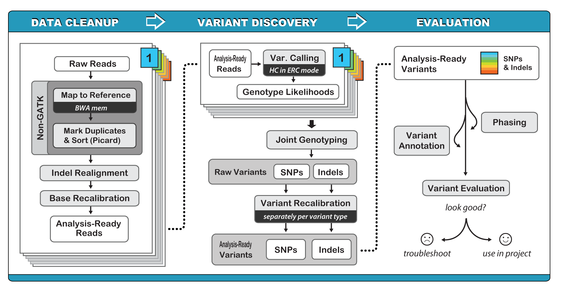


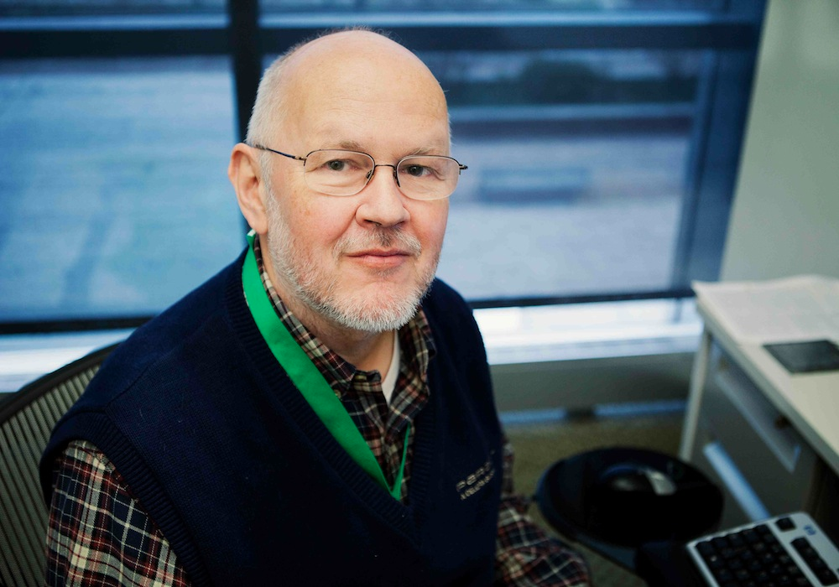

… HPCBio Workflows @ Illinois
Broad Institute: Recommended workflow for variant analysis
Quickly, say: #!/bin/bash
Liudmila Mainzer, Victor Jongeneel
HPC Bio @ Illinois
National Petascale Computing Facility

Slide 11


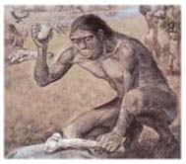
It’s time to shift control …
… back from being consumers of someone else’s (= our) tools ..
“Just click here!”
... to tool makers!
Scientists who author workflows as scripts!
Go where the wild things (users!) are …
Yes, develop for “end users” …
… but don’t forget the tool makers!
Can we do this together?

Slide 12
YesWorkflow: Yes, scripts are workflows, too!
?
Script vs Workflows/ASAP:
Automation: *****
Scaling: **
Abstraction: *
Provenance: **

Slide 13
Enter: YesWorkflow! (yesworkflow.org)
YesWorkflow (YW)
Grass-roots effort
… meeting the scientists/users where they R!
R, Matlab, (i)Python, Jupyter, …
Scripts + simple user annotations
=> Reveal the workflow model/abstraction
… that underlies the (script) implementation
=> YW can give us more of ASAP!
First YW: ASAP (Abstraction)...
Then YW-recon: ASAP (reconstructing runtime Provenance)

Slide 14
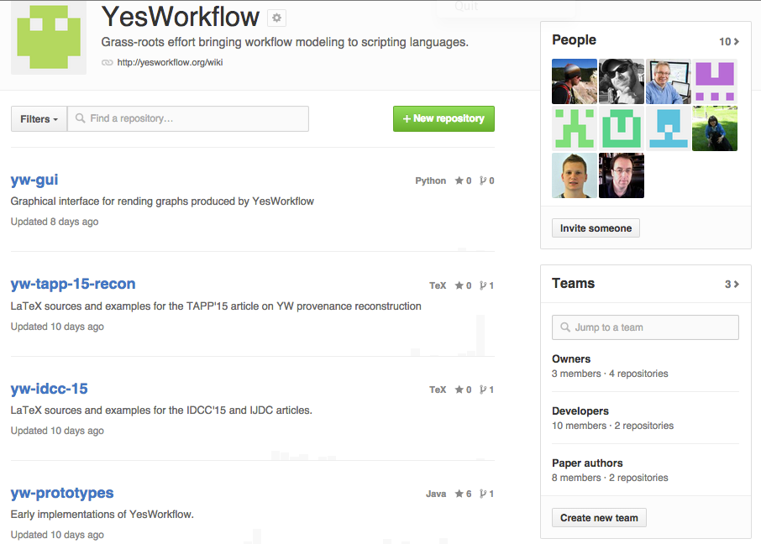
YesWorkflow.org

Slide 15
Related Work, other Approaches
… to bring workflow/provenance benefits to scripts:
Runtime Provenance Recorders:
use (R, Python, ..) libraries and/or code instrumentation to capture runtime observables
file read/write, function calls, program variables & state, …
noWorkflow system
[Murta-Braganholo-Chirigati-Koop-Freire-IPAW14]
exploit Python profiling library to capture runtime provenance
=> helps with "S" and "P"
OS-level capture of (system) provenance
Some talks at TaPP !?

Slide 16
YW (prospective) and YW-Recon (retrospective) Provenance
1. YW: Annotate Script => YW Model
Annotate @BEGIN..@END, @IN, @OUT
Visualize, share, be happy ☺
2. Run script
Files are read and written
Folder- & Filenames have metadata
3. YW-Recon
Use @URI tags that link YW Model ⬄ Persisted Data
Run URI-template queries
cf. “ls -R” & RegEx matching
4. YW-Query
Answer the user’s provenance queries

Slide 17
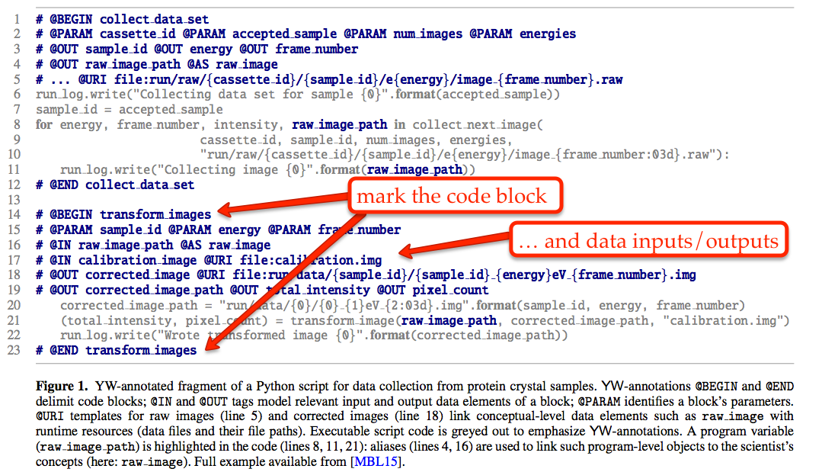
YW annotations: Model your Workflow!

Slide 18
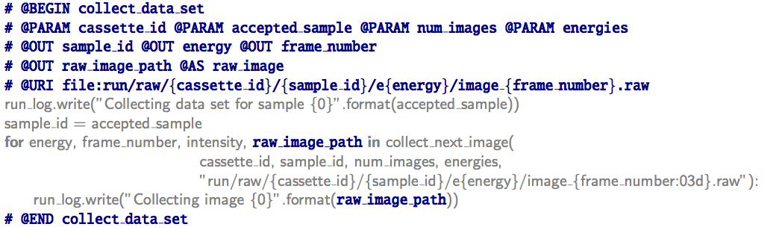
YesWorkflow: Prospective & Retrospective Provenance … (almost) for free!
YW!
YW annotations in the script (R, Python, Matlab) are used to recreate the workflow view from the script …

Slide 19
Voila! The Workflow revealed!

Slide 20

Get 3 views for the price of 1!
Process view
Data view
Combined view

Slide 21
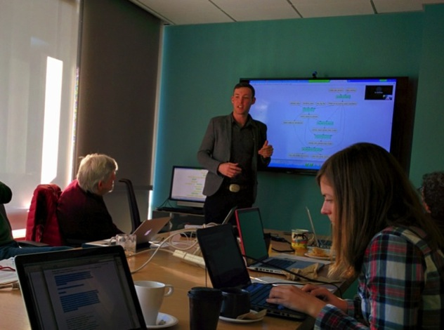

Paleoclimate Reconstruction (EnviRecon.org)
… explained using YesWorkflow!
Kyle B., (computational) archaeologist:
"It took me about 20 minutes to comment. Less than an hour to learn and YW-annotate, all-told."
SKOPE
+
Kurator
+
=> YesWorkflow.org

Slide 22
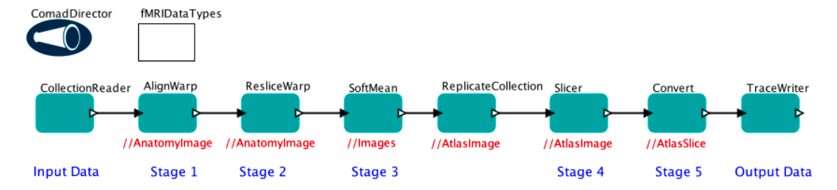
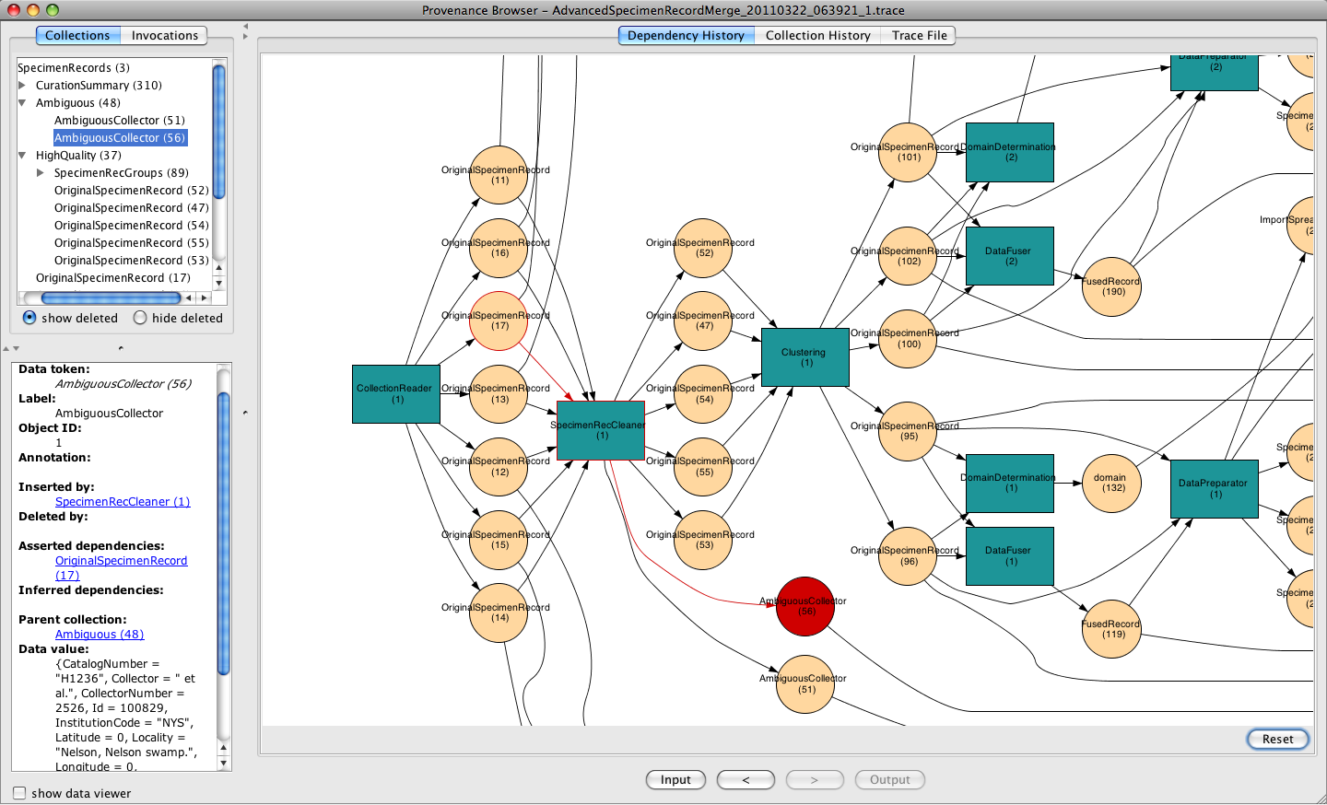
Provenance Lands
Workflow Modeling & Design
(a.k.a. prospective provenance
“Workflow-land”)
Runtime Provenance
(a.k.a. traces, logs, retrospective provenance,
“Trace-land”)

Slide 23
YW-RECON: Prospective & Retrospective Provenance … (almost) for free!
URI-templates link conceptual entities to runtime provenance “left behind” by the script author …
… facilitating provenance reconstruction

Slide 24
YW (prospective) and YW-Recon (retrospective) Provenance
1. YW: Annotate Script => YW Model
Annotate @BEGIN..@END, @IN, @OUT
Visualize, share, be happy ☺
2. Run script
Files are read and written
Folder- & Filenames have metadata
3. YW-Recon
Use @URI tags that link YW Model ⬄ Persisted Data
Run URI-template queries
cf. “ls -R” & RegEx matching
4. YW-Query
Answer the user’s provenance queries

Slide 25
Data collection workflow (X-ray diffraction )
Notes:
This is the information we have available to satisfy queries:
The YW annotations and the resulting YW model of the script including URI templates describing any expected outputs (left).
The files and directories actually left by a run of the script (right).

Slide 26
Data collection workflow: runtime data
YW annotations => YW model
Files & Folders left by a run => runtime (meta-)data
Notes:
This is the information we have available to satisfy queries:
The YW annotations and the resulting YW model of the script including URI templates describing any expected outputs (left).
The files and directories actually left by a run of the script (right).

Slide 27
Q₁: What samples did the script run collect images from?
Notes:
Query 1: What samples did the run of the script collect images from?
Scientist: Look at the contents of the run/{}/q55 directories. The names of subdirectories are the names of the samples collected on.
YW: Return values of sample_id as seen by collect_data_set and recorded in expansions of URI template for raw_image.

Slide 28
Q₂: What energies were used for image collection from sample DRT322?
Notes:
Query 2: What energies were used during collection of images from sample DRT322?
Scientist: Look at the contents of the run/raw/q55/DRT322 directory. The names of subdirectories indicate the values of the energies.
YW: look for all persisted outputs of collect_data_set that include both energy and sample_id in the expanded URI template for the output. Extract the value of energy from each such path for which sample_id equals DRT322.

Slide 29
Q₃: Where is the raw image of the corrected image DRT322_11000ev_030.img?
Notes:
Query 3: Where is the raw image corresponding to corrected image DRT322_11000ev_028.img
Scientist: Look at the image files nested within the raw directory. Find the image file that contains the values DRT322, 11000, and 028 in the file access path.
YW: Extract the URI template variable names and values from the path to DRT322_11000ev_028.img output by the port named corrected_image, look at the paths for all files output by the raw_image port, and return the file whose path includes template variables with names and values matching those for DRT322_11000ev_028.img

Slide 30
Q₅: What cassette-id had the sample leading to DRT240_10000ev_001.img?
Notes:
Query 5: What was the id of the cassette from which the sample leading to DRT240_10000eV_010.img was taken?
YW: Search the upstream lineage of data provided to transform_images, looking for URI templates that include cassette_id and sample_id as template variables. Return the value of cassette_id that occurs in URI expansions where sample_id matches DRT240.

Slide 31
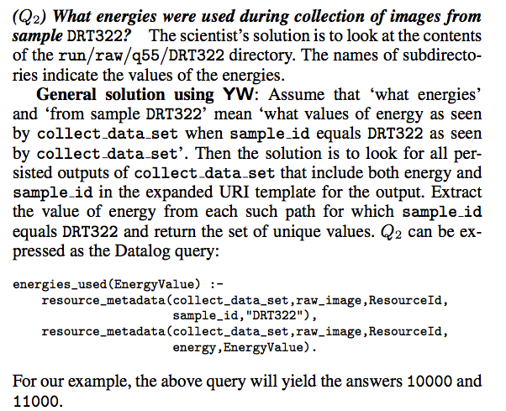
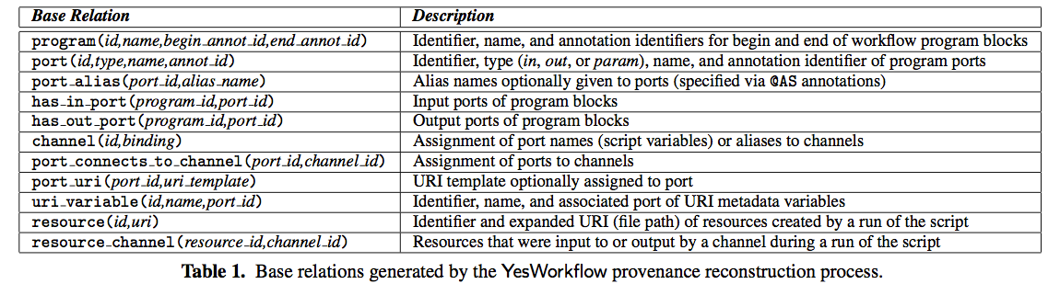
Querying Provenance

Slide 32
Data & Workflow Management
Large total data footprint
Large number of files
Large number of simultaneous but independent non-MPI computations
Keeping track of what was done to the data: large amount of metadata
Workflow bottlenecks: fans & merges; more fans
Source: L Mainzer, V Jongeneel (IGB & NCSA)

Slide 33
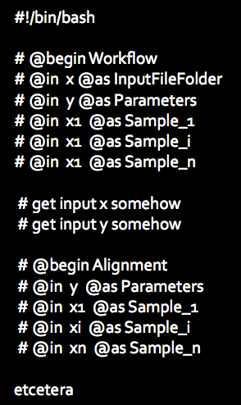
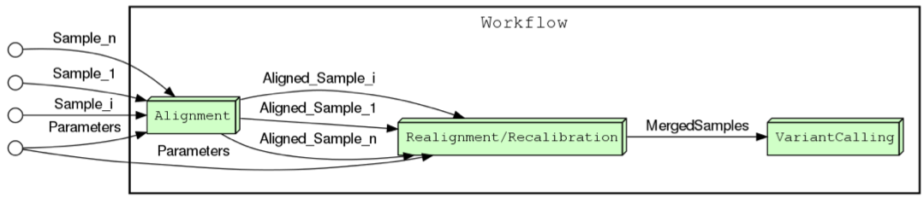
Taking YW for a spin …
“To document on-the fly, specifically for a given workflow configuration invoked:
do not insert annotations into code,
but rather have code print annotations into a special log during execution,
then parse that log!” – Liudmila Mainzer
Source: L Mainzer, V Jongeneel (IGB & NCSA)

Slide 34
Conclusions & the Road ahead …
YW: Go where the users are!
… they already capture provenance through metadata!
Beware your level of provenance abstraction
Let the user provide a workflow model easily!
YW-Recon:
… finishing support for retrospective provenance without using a runtime provenance recorder!
Key insight: scientists already leave provenance “bread crumbs” behind! (it’s not an accident!)
Exploit this annotations: URI-templates
Extend YW to exploit log files
YW-GUI:
Exploring & experimenting with a UI
Let script author immediately see effect of YW-annotations
Let scrip (re-)user explore the code and data provenance
YW-Query:
? Datalog, RPQ, … for querying provenance …

